Slide 1



Hash Tables, Sets and Dictionaries
Hashing and Collisions
Hash
Tables
SoftUni Team
0 | 1 | 2 | … | m-1
Technical Trainers
null | null | Pesho | … | Lili
Software University
http://softuni.bg

Slide 2

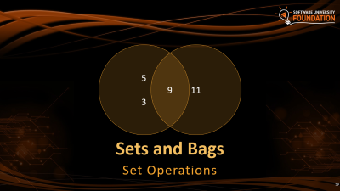

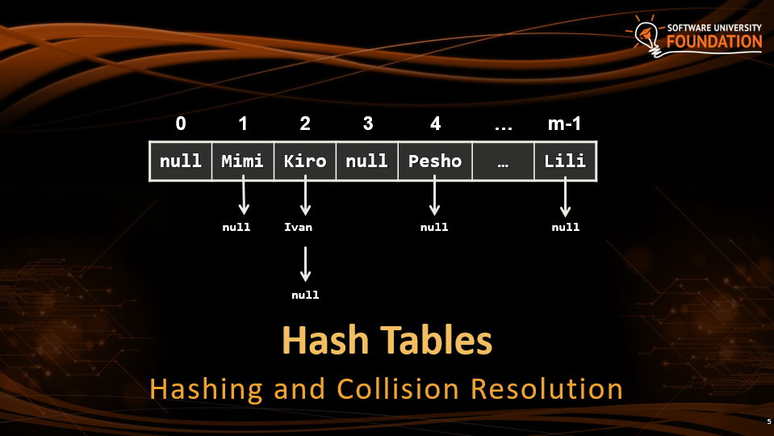
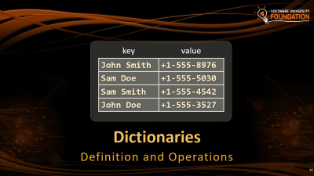
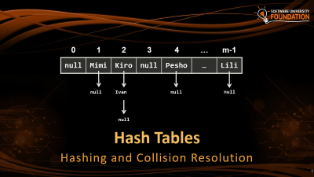
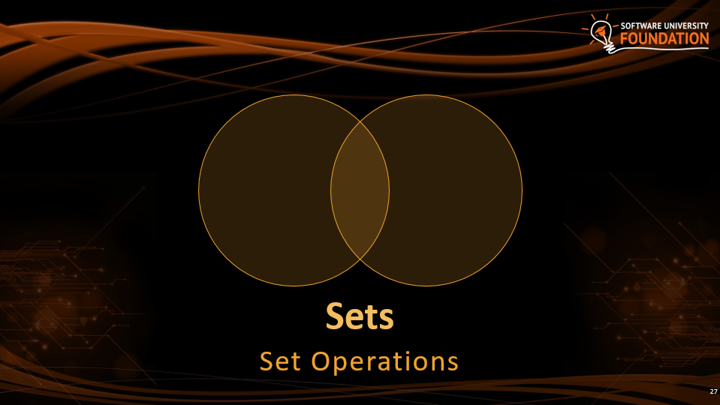
Table of Contents

Slide 3
Hash Tables
0 | 1 | 2 | 3 | 4 | … | m-1
null | Mimi | Kiro | null | Pesho | … | Lili
null
Ivan
null
null
null
Hashing and Collision Resolution

Slide 4
Hash Function
Given a key of any type, convert it to an integer
Ivan
Hash Function
398
Pesho
Hash Function
511
class Person
{
string firstName;
string lastName;
int age;
}
Ivan
Petrov
25
Hash Function
25950

Slide 5
Hash Function (2)
class Person
{
string firstName;
string lastName;
int age;
public override int GetHashCode()
{
int firstNameHash = firstName.GetHashCode() * age;
int lastNameHash = lastName.GetHashCode() * age;
return firstNameHash + lastNameHash;
}
}
Hash Function

Slide 6
Hash Function (3)
class Person
{
string firstName;
string lastName;
int age;
public override int GetHashCode()
{
int firstNameHash = firstName.GetHashCode() * age;
int lastNameHash = lastName.GetHashCode() * age;
return firstNameHash + lastNameHash;
}
}

Slide 7
Hash Table
A hash table is an array that holds a set of {key, value} pairs
The process of mapping a key to a position in a table is called hashing
0 | 1 | 2 | 3 | 4 | 5 | … | m-1
T
… | … | … | … | … | … | … | …
Hash table of size m

Slide 8
Hash Functions and Hashing
A hash table has m slots, indexed from 0 to m-1
A hash function converts keys into array indices
0 | 1 | 2 | 3 | 4 | 5 | … | m-1
T
… | … | … | … | … | … | … | …
k.GetHashCode()
Returns 32-bit integer

Slide 9
Hashing Functions
Perfect hashing function (PHF)
h(k): one-to-one mapping of each key k to an integer in the range [0, m-1]
The PHF maps each key to a distinct integer within some manageable range
Finding a perfect hashing function is impossible in most cases

Slide 10
Hashing Functions (2)
Good hashing function
Consistent - equal keys must produce the same hash value
Efficient - efficient to compute the hash
Uniform - should uniformly distribute the keys

Slide 11
Hash Functions - Quiz
TIME’S UP!
TIME:
Which of the following is not property of a GetHashCode() for strings
Can return a negative integer
Can take time proportional to the length of the string to compute
A string and its reverse will have the same hash code
Two strings with different hash code values are different strings

Slide 12

Hash Functions - Answer
Which of the following is not property of a GetHashCode() for strings
Can return a negative integer
Can take time proportional to the length of the string to compute
A string and its reverse will have the same hash code
Two strings with different hash code values are different strings
"ab".GetHashCode() != "ba".GetHashCode()

Slide 13
Modular Hashing
Array with length 16
Insert "Pesho"
Use the remainder of GetHashCode() / Array.Length
511 is bigger than the table length
 | 0
 | 1
 | 2
 | 3
 | 4
 | 5
 | 6
 | 7
… | …
 | 15
Pesho
Hash Function
511
511 % 16 = 15

Slide 14
Adding to Hash Table
 | 0
 | 1
 | 2
 | 3
 | 4
 | 5
 | 6
 | 7
 | 8
 | 9
Hash Function % 10
stamat

Slide 15
Adding to Hash Table (2)
 | 0
 | 1
 | 2
 | 3
 | 4
 | 5
 | 6
 | 7
 | 8
 | 9
stamat
Hash Function % 10
mitko

Slide 16
Adding to Hash Table (3)
 | 0
 | 1
 | 2
 | 3
 | 4
 | 5
 | 6
 | 7
 | 8
 | 9
stamat
Hash Function % 10
ivan
mitko

Slide 17
Adding to Hash Table (4)
 | 0
 | 1
 | 2
 | 3
 | 4
 | 5
 | 6
 | 7
 | 8
 | 9
stamat
Hash Function % 10
ivan
gosho
mitko

Slide 18
Adding to Hash Table (5)
 | 0
 | 1
 | 2
 | 3
 | 4
 | 5
 | 6
 | 7
 | 8
 | 9
stamat
Hash Function % 10
ivan
maria
mitko
gosho

Slide 19

Adding to Hash Table (6)
 | 0
 | 1
 | 2
 | 3
 | 4
 | 5
 | 6
 | 7
 | 8
 | 9
Collision
stamat
Hash Function % 10
maria
ivan
mitko
gosho

Slide 20
Collisions in a Hash Table
A collision comes when different keys have the same hash value
h(k₁) = h(k₂) for k₁ ≠ k₂
When the number of collisions is sufficiently small, the hash tables work quite well (fast)
Several collisions resolution strategies exist
Chaining collided keys (+ values) in a list
Using other slots in the table (open addressing)
Cuckoo hashing
Many other

Slide 21
Collision Resolution: Chaining
Hash Function
maria
0 | 1 | 2 | 3 | 4 | 5 | 6 | 7

Slide 22
Collision Resolution: Chaining
Hash Function
ivan
0 | 1 | 2 | 3 | 4 | 5 | 6 | 7
maria

Slide 23
Collision Resolution: Chaining
Hash Function
stamat
0 | 1 | 2 | 3 | 4 | 5 | 6 | 7
maria
ivan

Slide 24
Collision Resolution: Chaining
Hash Function
pesho
0 | 1 | 2 | 3 | 4 | 5 | 6 | 7
stamat
maria
ivan

Slide 25

Collision Resolution: Chaining
Hash Function
mitko
0 | 1 | 2 | 3 | 4 | 5 | 6 | 7
stamat
maria
ivan
pesho
Items are chained into a linked list

Slide 26
Collision Resolution: Chaining
Hash Function
joro
0 | 1 | 2 | 3 | 4 | 5 | 6 | 7
stamat
maria
ivan
mitko
pesho

Slide 27
Collision Resolution: Chaining
Hash Function
rosi
0 | 1 | 2 | 3 | 4 | 5 | 6 | 7
stamat
maria
ivan
mitko
pesho
joro

Slide 28
Collision Resolution: Chaining
Hash Function
alex
0 | 1 | 2 | 3 | 4 | 5 | 6 | 7
rosi
stamat
maria
ivan
mitko
pesho
joro

Slide 29
Collision Resolution: Chaining
Hash Function
0 | 1 | 2 | 3 | 4 | 5 | 6 | 7
rosi
stamat
maria
ivan
mitko
pesho
joro
alex

Slide 30
Separate Chaining - Summary
Structure | Worst case |  |  | Average case
 | Search | Insert | Delete | Search Hit | Insert
BST | N | N | N | 1.39 lg N | 1.39 lg N
2-3 Tree | c lg N | c lg N | c lg N | c lg N | c lg N
Red-Black | 2 lg N | 2 lg N | 2 lg N | lg N | lg N
AVL Tree | 1.44 lg N | 1.44 lg N | 1.44 lg N | lg N | lg N
Chaining | lg N | lg N | lg N | 3-5 | 3-5
Under uniform hasing assumption

Slide 31
Collision Resolution: Open Addressing
Open addressing as collision resolution strategy means to take another slot in the hash-table in case of collision, e.g.
Linear probing: take the next empty slot just after the collision
h(key, i) = h(key) + i
where i is the attempt number: 0, 1, 2, …
h(key) + 1, h(key) + 2, h(key) + 3, etc.

Slide 32
Collision Resolution: Open Addressing (2)
Quadratic probing: the i^{th} next slot is calculated by a quadratic polynomial (c₁ and c₂ are some constants)
h(key, i) = h(key) + c₁*i + c₂*i²
h(key) + 1², h(key) + 2², h(key) + 3², etc.
Re-hashing: use separate (second) hash-function for collisions
h(key, i) = h₁(key) + i*h₂(key)

Slide 33
Collision Resolution: Linear Probing
Hash Function
maria
0 | 1 | 2 | 3 | 4 | 5 | 6 | 7

Slide 34
Collision Resolution: Linear Probing
Hash Function
ivan
0 | 1 | 2 | 3 | 4 | 5 | 6 | 7
maria

Slide 35
Collision Resolution: Linear Probing
Hash Function
stamat
0 | 1 | 2 | 3 | 4 | 5 | 6 | 7
maria
ivan

Slide 36
Collision Resolution: Linear Probing
Hash Function
pesho
0 | 1 | 2 | 3 | 4 | 5 | 6 | 7
stamat
maria
ivan

Slide 37
Collision Resolution: Linear Probing
Hash Function
pesho
0 | 1 | 2 | 3 | 4 | 5 | 6 | 7
stamat
maria
ivan

Slide 38
Collision Resolution: Linear Probing
Hash Function
pesho
0 | 1 | 2 | 3 | 4 | 5 | 6 | 7
stamat
maria
ivan

Slide 39
Collision Resolution: Linear Probing
Hash Function
mitko
0 | 1 | 2 | 3 | 4 | 5 | 6 | 7
stamat
maria
pesho
ivan

Slide 40
Collision Resolution: Linear Probing
Hash Function
joro
0 | 1 | 2 | 3 | 4 | 5 | 6 | 7
stamat
maria
pesho
ivan
mitko

Slide 41
Collision Resolution: Linear Probing
Hash Function
joro
0 | 1 | 2 | 3 | 4 | 5 | 6 | 7
stamat
maria
pesho
ivan
mitko

Slide 42
Collision Resolution: Linear Probing
Hash Function
joro
0 | 1 | 2 | 3 | 4 | 5 | 6 | 7
stamat
maria
pesho
ivan
mitko

Slide 43
Collision Resolution: Linear Probing
Hash Function
rosi
0 | 1 | 2 | 3 | 4 | 5 | 6 | 7
stamat
maria
pesho
ivan
joro
mitko

Slide 44
Collision Resolution: Linear Probing
Hash Function
alex
0 | 1 | 2 | 3 | 4 | 5 | 6 | 7
rosi
stamat
maria
pesho
ivan
joro
mitko

Slide 45
Collision Resolution: Linear Probing
Hash Function
alex
0 | 1 | 2 | 3 | 4 | 5 | 6 | 7
rosi
stamat
maria
pesho
ivan
joro
mitko

Slide 46
Collision Resolution: Linear Probing
Hash Function
alex
0 | 1 | 2 | 3 | 4 | 5 | 6 | 7
rosi
stamat
maria
pesho
ivan
joro
mitko

Slide 47
Collision Resolution: Linear Probing
Hash Function
alex
0 | 1 | 2 | 3 | 4 | 5 | 6 | 7
rosi
stamat
maria
pesho
ivan
joro
mitko

Slide 48
Collision Resolution: Linear Probing
Hash Function
alex
0 | 1 | 2 | 3 | 4 | 5 | 6 | 7
rosi
stamat
maria
pesho
ivan
joro
mitko

Slide 49
Collision Resolution: Linear Probing
Hash Function
alex
0 | 1 | 2 | 3 | 4 | 5 | 6 | 7
rosi
stamat
maria
pesho
ivan
joro
mitko

Slide 50
Collision Resolution: Linear Probing
Hash Function
0 | 1 | 2 | 3 | 4 | 5 | 6 | 7
rosi
alex
stamat
maria
pesho
ivan
joro
mitko

Slide 51
Linear Probing - Quiz
TIME’S UP!
TIME:
What is the average running time of delete in linear-probing hash table? Your hash function satisfies the uniform hashing assumption and that the hash table is at most 50% full.
O(1)
O(log N)
O(N)
O(N log N)

Slide 52
Linear Probing - Answer
What is the average running time of delete in linear-probing hash table? Your hash function satisfies the uniform hashing assumption and that the hash table is at most 50% full.
O(1)
O(log N)
O(N)
O(N log N)

Slide 53
Linear Probing - Summary
Structure | Worst case |  |  | Average case
 | Search | Insert | Delete | Search Hit | Insert
BST | N | N | N | 1.39 lg N | 1.39 lg N
2-3 Tree | c lg N | c lg N | c lg N | c lg N | c lg N
Red-Black | 2 lg N | 2 lg N | 2 lg N | lg N | lg N
AVL Tree | 1.44 lg N | 1.44 lg N | 1.44 lg N | lg N | lg N
Chaining | lg N | lg N | lg N | 3-5 | 3-5
L. Probing | lg N | lg N | lg N | 3-5 | 3-5

Slide 54
Hash Table Performance
The hash-table performance depends on the probability of collisions
Less collisions → faster add / find / delete operations
Collisions resolution algorithm
Fill factor (used buckets / all buckets)

Slide 55
Hash Tables Efficiency
Add / Find / Delete take just few primitive operations
Speed does not depend on the size of the hash-table
Amortized complexity O(1) – constant time
Example:
Finding an element in a hash-table holding 1 000 000 elements takes average just 1-2 steps
Finding an element in an array holding 1 000 000 elements takes average 500 000 steps

Slide 56
How Big the Hash-Table Should Be?
The load factor (fill factor) = used cells / all cells
How much the hash table is filled, e.g. 65%
Smaller fill factor leads to less collisions (faster average seek time)
Recommended fill factors:
When chaining is used as collision resolution → less than 75%
When open addressing is used → less than 50%

Slide 57
Adding Item to Hash Table With Chaining
Add("Tanio")
hash("Tanio") % m = 3
map[3] == null?
yes
Initiliaze
linked list
Fill factor >= 75%?
no
yes
Insert("Tanio")
0 | 1 | 2 | 3 | 4 | … | m-1
Resize & rehash
T
null | Mimi | Kiro | null | null | … | Lili
Ivan
null
null
null

Slide 58

Lab Exercise
Implement a Hash-Table with Chaining

Slide 59
Sets and Bags
5
9
3
11
Set Operations

Slide 60
Set and Bag ADTs
The abstract data type (ADT) "set" keeps a set of elements with no duplicates
Sets with duplicates are also known as ADT "bag"
Set specific operations:
UnionWith(set)
IntersectWith(set)
ExceptWith(set)
SymmetricExceptWith(set)
Known as relative complement in math
Known as symmetric difference

Slide 61
Union
1 | 5 | 2 | 11 | 8 | 34
3 | 2 | 9 | 34 | 8 | 0

Slide 62
Union
1 | 5 | 2 | 11 | 8 | 34
3 | 2 | 9 | 34 | 8 | 0
1 | 5 | 2 | 11 | 8 | 34 | 3 | 9 | 0

Slide 63
Union
1 | 5 | 2 | 11 | 8 | 34
3 | 2 | 9 | 34 | 8 | 0
1 | 5 | 2 | 11 | 8 | 34 | 3 | 9 | 0

Slide 64
Intersects
1 | 5 | 2 | 11 | 8 | 34
3 | 2 | 9 | 34 | 8 | 0

Slide 65
Intersects
1 | 5 | 2 | 11 | 8 | 34
3 | 2 | 9 | 34 | 8 | 0
2 | 8 | 34

Slide 66
Intersects
1 | 5 | 2 | 11 | 8 | 34
3 | 2 | 9 | 34 | 8 | 0
2 | 8 | 34

Slide 67
Except
1 | 5 | 2 | 11 | 8 | 34
3 | 2 | 9 | 34 | 8 | 0

Slide 68
Except
1 | 5 | 2 | 11 | 8 | 34
3 | 2 | 9 | 34 | 8 | 0
1 | 5 | 11

Slide 69
Except
1 | 5 | 2 | 11 | 8 | 34
3 | 2 | 9 | 34 | 8 | 0
1 | 5 | 11

Slide 70
Symmetric Except
1 | 5 | 2 | 11 | 8 | 34
3 | 2 | 9 | 34 | 8 | 0

Slide 71
Symmetric Except
1 | 5 | 2 | 11 | 8 | 34
3 | 2 | 9 | 34 | 8 | 0
1 | 5 | 11 | 3 | 9 | 0

Slide 72
Symmetric Except
1 | 5 | 2 | 11 | 8 | 34
3 | 2 | 9 | 34 | 8 | 0
1 | 5 | 11 | 3 | 9 | 0

Slide 73
Live Demo
Implementing Set Operations

Slide 74

.NET Implementations
HashSet<T> and SortedSet<T>

Slide 75
HashSet<T>
HashSet<T> implements ADT set by hash table
Elements are in no particular order
All major operations are fast: Add / Delete / Contains
0 | 1 | 2 | 3 | 4 | 5 | 6 | 7
rosi
stamat
maria
ivan
mitko
pesho
joro
alex

Slide 76
SortedSet<T>
SortedSet<T> implements ADT set by balanced search tree (red-black tree)
Elements are sorted in increasing order
5
3
18
1
8
19

Slide 77
Sets - Quiz
TIME’S UP!
TIME:
For given sets - {1, 2, 3, 4, 5} and {3, 4, 5, 6, 7}, what is the operation that will give us the following result: {1, 2, 6, 7}
Union
Intersects
Except
SymmetricExcept

Slide 78
Sets - Answer
For given sets - {1, 2, 3, 4, 5} and {3, 4, 5, 6, 7}, what is the operation that will give us the following result: {1, 2, 6, 7}
Union
Intersects
Except
SymmetricExcept

Slide 79
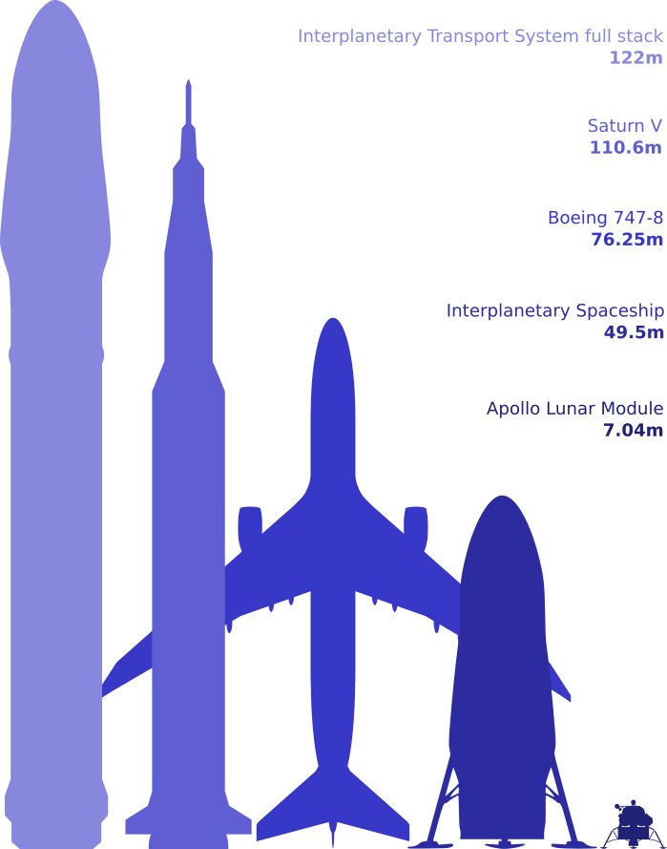
Comparing Keys
Using Custom Key Classes

Slide 80
Comparasion Methods
Dictionary<TKey,TValue> relies on
Object.Equals() – for comparing the keys
Object.GetHashCode() – for calculating the hash codes of the keys
SortedDictionary<TKey,TValue> relies on IComparable<T> for ordering the keys

Slide 81
Implementing Equals() and GetHashCode()
public class Point
{
public int X { get; set; }
public int Y { get; set; }
public override bool Equals(Object obj)
{
if (!(obj is Point) || (obj == null)) return false;
Point p = (Point)obj;
return (X == p.X) && (Y == p.Y);
}
public override int GetHashCode()
{
return (X << 16 | X >> 16) ^ Y;
}
}

Slide 82
Implementing IComparable<T>
public class Point : IComparable<Point>
{
public int X { get; set; }
public int Y { get; set; }
public int CompareTo(Point otherPoint)
{
if (X != otherPoint.X)
{
return this.X.CompareTo(otherPoint.X);
}
else
{
return this.Y.CompareTo(otherPoint.Y);
}
}
}

Slide 83
Dictionaries
key
value
John Smith | +1-555-8976
Sam Doe | +1-555-5030
Sam Smith | +1-555-4542
John Doe | +1-555-3527
Definition and Operations

Slide 84
The Dictionary (Map) ADT
The abstract data type (ADT) "dictionary" maps key to values
Also known as "map" or "associative array"
Holds a set of {key, value} pairs
Many implementations
Hash table, balanced tree, list, array, ...
key
value
John Smith | +1-555-8976
Sam Doe | +1-555-5030

Slide 85
ADT Dictionary – Example
Sample dictionary:
Key | Value
C# | Modern general-purpose object-oriented programming language for the Microsoft .NET platform
PHP | Popular server-side scripting language for Web development
compiler | Software that transforms a computer program to executable machine code
… | …

Slide 86
Dictionary<TKey,TValue>
Exception when the key already exists
Major operations:
Add(key, value) – adds an element by key + value
Remove(key) – removes a value by key
this[key] = value – add / replace element by key
this[key] – gets an element by key
Keys – returns a collection of all keys (in order of entry)
Values – returns a collection of all values (in order of entry)
Returns true / false
Exception on non-existing key

Slide 87
Dictionary<TKey,TValue> (2)
Major operations:
ContainsKey(key) – checks if given key exists in the dictionary
ContainsValue(value) – checks whether the dictionary contains given value
Warning: slow operation – O(n)
TryGetValue(key, out value)
If the key is found, returns it in the value parameter
Otherwise returns false

Slide 88
SortedDictionary<TKey,TValue>
SortedDictionary<TKey,TValue> implements the ADT "dictionary" as self-balancing search tree
Elements are arranged in the tree ordered by key
Traversing the tree returns the elements in increasing order
Add / Find / Delete perform log N operations
Use SortedDictionary<TKey,TValue> when you need the elements sorted by key
Otherwise use Dictionary<TKey,TValue> – it has better performance

Slide 89
Live Demo
Sets and Dictionaries Examples

Slide 90
Dictionaries - Quiz
TIME’S UP!
TIME:
Which built-in implementation of IDictionary<TKey, TValue> sorts the items by value?
Dictionary<TKey, TValue>
SortedDictionary<TKey, TValue>
PowerCollections.MultiDictionary<TKey, TValue>
None

Slide 91
Dictionaries - Answer
Which built-in implementation of IDictionary<TKey, TValue> sorts the items by value?
Dictionary<TKey, TValue>
SortedDictionary<TKey, TValue>
PowerCollections.MultiDictionary<TKey, TValue>
None

Slide 92
Hash Tables - Quiz
TIME’S UP!
TIME:
Which is the main reason to use a hash table instead of a red-black BST?
Supports more operations efficiently
Better worst-case performance guarantee
Better performance in practice on typical inputs

Slide 93
Hash Tables - Answer
Which is the main reason to use a hash table instead of a red-black BST?
Supports more operations efficiently
Better worst-case performance guarantee
Better performance in practice on typical inputs

Slide 94
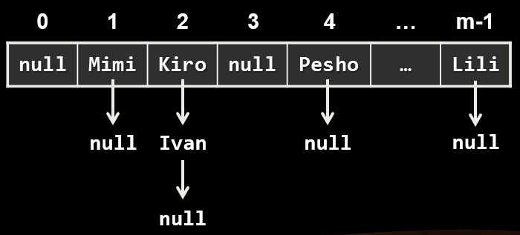
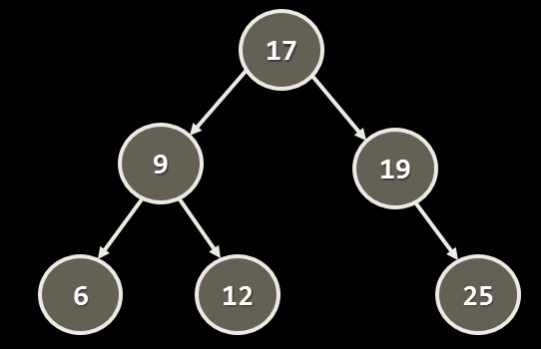
Dictionaries and Sets Comparison
Data Structure | Internal Structure | Time Compexity (Add/Update/Delete)
Dictionary<K,V> HashSet<K> |  | amortized O(1)
SortedDictionary<K,V> SortedSet<K> |  | O(log(n))

Slide 95

Summary
Hash-tables map keys to values
Rely on hash-functions to distribute the keys in the table
Collisions needs resolution algorithm (e.g. chaining)
Very fast add / find / delete – O(1)
Sets hold a group of elements
Dictionaries map key to value

